Slide 1
Module 9 Domain-Specific Prompt Engineering: Prompts for coding tasks, prompts for education and tutoring, prompts for business automation, Prompts for research assistance.

Slide 2
Domain-Specific Prompt Engineering
Domain-Specific Prompt Engineering means designing prompts that are tailored for a particular field or industry Rather than using general prompts.
Each domain such as healthcare, finance, or law has its own terminology, rules,
and professional standards.
Therefore, prompts must be written in a way that reflects the knowledge, context, and requirements of that specific field.

Slide 3
Definition
Domain-Specific Prompt Engineering is the process of customizing prompts according to the needs, terminology, and regulations of a specific domain to obtain accurate and relevant AI responses.
Domain Adaptation
Prompts should match the language and concepts used in a particular industry. Example:
Medical prompts use clinical terms.
Financial prompts use economic and accounting terms.

Slide 4
Contextual Specificity
The prompt must provide clear background information so the AI understands the situation.
Example: Instead of writing “Explain treatment.”
Write “Explain treatment options for type-2 diabetes in adult patients.”

Slide 5
Terminology Precision
Each field has technical vocabulary and acronyms. Using the correct terminology improves the quality of responses.
Example:
Medical: diagnosis, prognosis, symptoms
Finance: ROI, equity, liabilities
Legal: clause, jurisdiction, statute

Slide 6
Regulatory and Ethical Awareness
Some domains are highly regulated, so prompts should consider rules and ethical standards.
Examples:
Healthcare → patient privacy
Finance → regulatory compliance
Law → legal accuracy and jurisdiction

Slide 7
Output Formatting
The response format should follow professional standards of the domain.
Examples:
Medical: SOAP format (Subjective, Objective, Assessment, Plan)
Legal: numbered clauses and sections
Finance: balance sheets, profit/loss statements

Slide 8
Domain-Specific Prompt Examples
Healthcare: "Summarize treatment options for hypertension using clinical terminology."
Finance: "Analyze quarterly sales data and highlight profit trends."
Legal: "Draft a simple confidentiality agreement with numbered clauses."
Education: "Explain database normalization for undergraduate students."
Cybersecurity: "Identify security vulnerabilities in the given system description."
Business: "Generate a brief market analysis for an AI startup."
Engineering: "Explain the working principle of a heat engine with key equations."
Data Science: "Describe steps to build a machine learning classification model."
Human Resources: "Create interview questions for a software developer role."
Marketing: "Write a short digital marketing strategy for a new product."
Research: "Summarize recent trends in federated learning research."
Agriculture: "Suggest sustainable farming techniques for improving soil health."

Slide 9
Basic Syntax
Domain + Task/Action + Specific Context + Output Format
[Domain/Role] + [Task] + [Topic or Problem] + [Context/Details] + [Expected Output Format]
Domain / Role Specify the professional field. Example: Healthcare, Finance, Legal, Education
Task / Action Tell the AI what to do. Example: Explain, Analyze, Generate, Summarize
Topic / Problem Mention the specific subject. Example: Diabetes treatment, Balance sheet analysis
Context / Details Provide background information if required.
Output Format Mention how the answer should appear. Example: Table, Report, Bullet points

Slide 10
Applications
Healthcare
Medical report analysis
Patient care summaries
Clinical documentation
Finance
Financial data analysis
Fraud detection
Investment insights
Legal
Drafting legal documents
Contract analysis
Case summaries

Slide 11
Prompts for Coding Tasks
When writing prompts for coding tasks, the prompt should guide the AI like a precise blueprint.
A vague request produces messy code.
A structured prompt produces clean, usable programs.
Think of it like giving a chef a recipe instead of just saying “make food.”

Slide 12
Considerations
1. Programming Language
Always specify the language.
Example “Write a program in Python to sort a list.”
2. Problem Description
Clearly describe the task.
Example “Create a program that finds the largest number in an array.”

Slide 13
3. Input and Output
Define expected inputs and outputs.
Example Input: List of integers Output: Maximum value
4. Constraints and Conditions
Mention limitations or requirements.
Examples
Time complexity
Memory usage
Edge cases

Slide 14
5. Code Structure
Specify how the code should be organized.
Examples
Functions
Classes
Modular code
6. Documentation
Ask for comments or explanations.
Example “Include comments explaining each step.”
7. Testing
Request test cases.
Example “Provide sample inputs and outputs to test the program.”

Slide 15
8. Optimization
Ask for efficient solutions.
Example “Optimize the algorithm for large datasets.”
Simple Coding Prompt Template
Language + Task + Input + Output + Constraints + Format

Slide 16
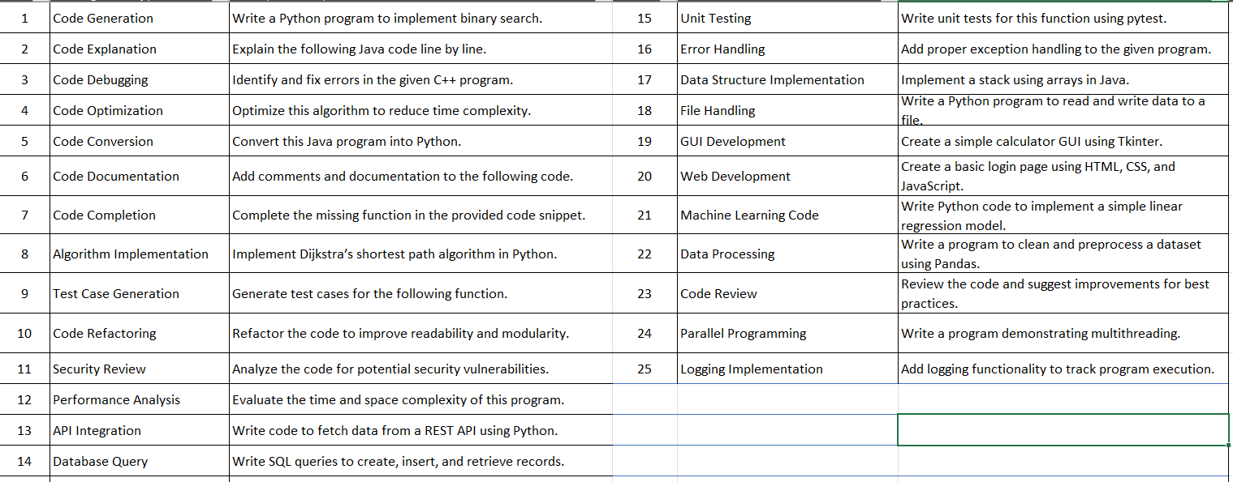

Slide 17
Lab Task
Create prompts that generate the same algorithm (e.g., factorial or sorting) in Python, Java, and C++. Compare the syntax and structure of the generated code.
Write prompts that generate test cases for a given function (e.g., prime number check or palindrome detection). Evaluate whether the generated test cases cover edge conditions.
Provide a program without comments. Write prompts asking AI to generate proper documentation and comments explaining the code functionality.
Create different prompts to generate the same program. Evaluate the generated code based on accuracy, efficiency, readability, and prompt length.

Slide 18
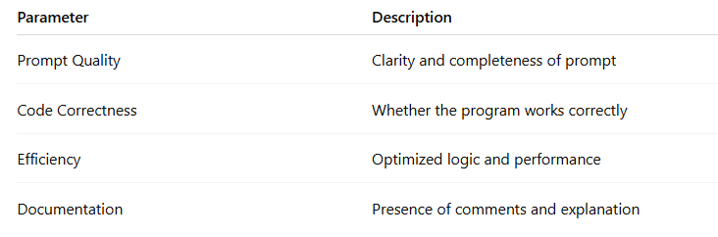
Quality Check

Slide 19
Prompts for Education and Tutoring
Educational and tutoring prompts are instructions given to an AI system to help teach concepts, explain topics, generate learning materials, assess student understanding, and support personalized learning.
These prompts guide the AI to act like a teacher, tutor, or learning assistant, providing explanations, examples, exercises, and feedback for students.
General Syntax for Educational Prompts
Role + Learning Level + Task + Topic + Output Format

Slide 20
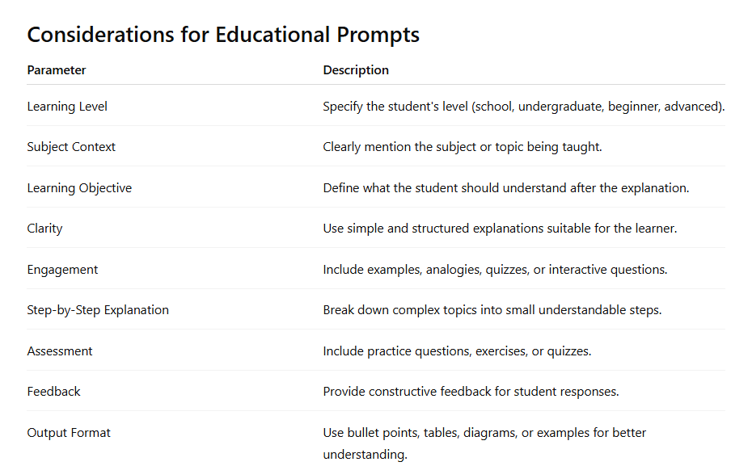

Slide 21
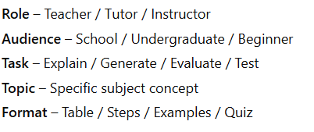
Educational Prompt Framework

Slide 22
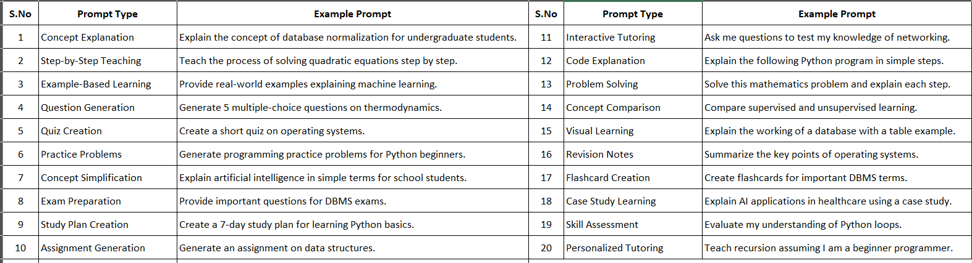

Slide 23
Prompts for Business Automation
Business automation prompts are instructions given to AI systems to automate routine business processes, such as generating reports, analyzing data, handling customer communication, scheduling tasks, and supporting decision-making.
These prompts help organizations reduce manual work, improve efficiency, and streamline operations across departments like marketing, finance, HR, a
nd customer support.
General Syntax for Business Automation Prompts
Role + Business Task + Data/Context + Expected Output Format

Slide 24
Considerations
Parameter | Description
Business Objective | Clearly state the goal such as reporting, analysis, or automation.
Data Input | Specify the type of data the AI should process (sales data, customer feedback, etc.).
Task Specification | Clearly define the task such as summarize, analyze, generate, or automate.
Output Format | Mention whether the output should be a report, table, email draft, or dashboard summary.
Accuracy and Compliance | Ensure the output follows business policies and regulatory guidelines.
Scalability | Design prompts that can work with large datasets or repeated tasks.
Integration | Ensure prompts support integration with tools like CRM, ERP, or analytics systems.

Slide 25
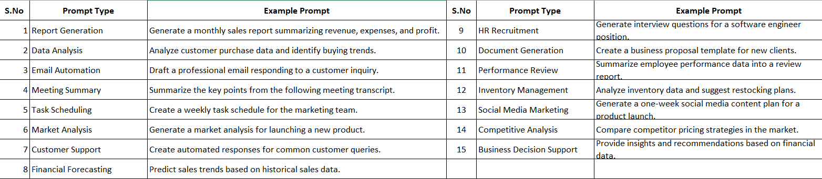

Slide 26
Business automation prompts
Business automation prompts are instructions given to AI systems to automate routine business processes, such as generating reports, analyzing data, handling customer communication, scheduling tasks, and supporting decision-making. These prompts help organizations reduce manual work, improve efficiency, and streamline operations across departments like marketing, finance, HR, and customer support.
Simple Prompt Structure
Business Role + Action + Data + Format
Example: Finance Analyst + Analyze + Sales Data + Report

Slide 27
Consideration
Parameter | Description
Business Objective | Clearly state the goal such as reporting, analysis, or automation.
Data Input | Specify the type of data the AI should process (sales data, customer feedback, etc.).
Task Specification | Clearly define the task such as summarize, analyze, generate, or automate.
Output Format | Mention whether the output should be a report, table, email draft, or dashboard summary.
Accuracy and Compliance | Ensure the output follows business policies and regulatory guidelines.
Scalability | Design prompts that can work with large datasets or repeated tasks.
Integration | Ensure prompts support integration with tools like CRM, ERP, or analytics systems.

Slide 28
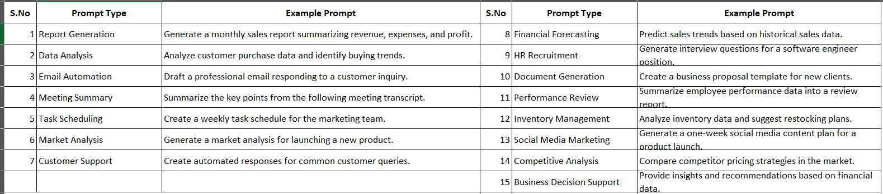

Slide 29
Prompts for Research Assistance
Research assistance prompts are structured instructions given to AI systems to help researchers explore topics, review literature, summarize papers, analyze data, generate research questions, and organize findings.
These prompts guide AI to act like a research assistant, supporting tasks in academic studies, scientific investigations, and scholarly writing.
General Syntax for Research Prompts
Research Role + Research Task + Topic + Context + Output Format

Slide 30
Considerations
Parameter | Description
Research Objective | Clearly define the research goal or question.
Domain Specification | Mention the specific research field (AI, healthcare, economics, etc.).
Data Sources | Specify whether to use journals, articles, datasets, or reports.
Depth of Analysis | Indicate whether a brief summary or detailed analysis is required.
Citation Style | Request citations in formats like APA, IEEE, or MLA if needed.
Methodology | Specify the research method such as qualitative or quantitative analysis.
Output Structure | Define format such as report, table, summary, or bullet points.
Accuracy | Ensure information is evidence-based and verifiable.
Ethical Considerations | Avoid plagiarism and ensure proper citation of sources.

Slide 31
